Slide 1
Chapters 2: Elementary Programming
The following topics will be covered in this chapter:
Input and output using cin and cout
Variables (identifiers)
Types and constants
Assignment, arithmetic operations, and arithmetic expressions
Operators and precedence
Shortcut, increment, and decrement operators
Built-in functions
Input and output using cin and cout
Comments in programs

Slide 2
Tracing the execution of sequential programs
Our initial programs will execute a sequence of instructions.
It is useful to trace through a program and see how instructions are executed in order, such as:
Variables are initialized
Values are assigned.
Values are calculated
Inputs are read from the keyboard
Outputs are send to the monitor
Etc,
Consider the program on the following slides where the area of a circle is calculated for a fixed radius.

Slide 3
Trace a Program Execution
animation
allocate memory for radius
#include <iostream>
using namespace std;
int main() {
double radius;
double area;
// Step 1: Read in radius
radius = 20;
// Step 2: Compute area
area = radius * radius * 3.14159;
// Step 3: Display the area
cout << "The area is ";
cout << area << endl;
}
radius
no value

Slide 4
Trace a Program Execution
animation
#include <iostream>
using namespace std;
int main() {
double radius;
double area;
// Step 1: Read in radius
radius = 20;
// Step 2: Compute area
area = radius * radius * 3.14159;
// Step 3: Display the area
cout << "The area is ";
cout << area << std::endl;
}
memory
radius
no value
area
no value
allocate memory for area

Slide 5
Trace a Program Execution
animation
assign 20 to radius
#include <iostream>
using namespace std;
int main() {
double radius;
double area;
// Step 1: Read in radius
radius = 20;
// Step 2: Compute area
area = radius * radius * 3.14159;
// Step 3: Display the area
cout << "The area is ";
cout << area << std::endl;
}
radius
20
area
no value

Slide 6
Trace a Program Execution
animation
#include <iostream>
using namespace std;
int main() {
double radius;
double area;
// Step 1: Read in radius
radius = 20;
// Step 2: Compute area
area = radius * radius * 3.14159;
// Step 3: Display the area
cout << "The area is ";
cout << area << std::endl;
}
memory
radius
20
area
1256.636
compute area and assign it to variable area

Slide 7
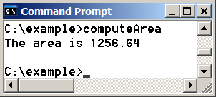
Trace a Program Execution
animation
#include <iostream>
using namespace std;
int main() {
double radius;
double area;
// Step 1: Read in radius
radius = 20;
// Step 2: Compute area
area = radius * radius * 3.14159;
// Step 3: Display the area
cout << "The area is ";
cout << area << std::endl;
}
memory
radius
20
area
1256.636
print a message to the console

Slide 8
Program Output using cout
cout is referred to as an “object” in C++.
cout is an output object that sends data to a standard output display device, such as the computer screen.
We will always use cout to send information to the computer screen.
Form:
cout << [variable, expression, or text (in double quotes)]
<< is referred to as the “insertion operator”
Example:
cout << “Hello”;
Send the text “Hello” to the screen (cout)

Slide 9
Examples: Program Output using cout
cout << “Hello”;
cout << x;
cout << sin(2*x+3); // Note that the result is displayed
cout << x << y;
cout << “x = “ << x;
cout << “Angle =“ << Angle << “degrees”;
equivalent
cout << x;
cout << y;
cout << z;
cout << x << y << z;

Slide 10
Strings
In the statement below, “Hello” is referred to as a string.
cout << “Hello”;
String: Any combination of letters, numbers, and special characters enclosed in double quotes (a delimiter)‏
Delimiter: A symbol that marks the beginning and ending of a string, but is not part of the string.
Connecting Strings
The backslash (\) can be used at end of a line to indicate that a string constant to continue with next line
The following two statements are equivalent:
cout << “This will \
continue on same line.” ;
cout << “This will continue on same line.” ;

Slide 11
Program Output using cout (continued)
C++ does not automatically advance the display to the next line after using cout.
A “line feed” is created by using either of the following:
endl (endline)
\n (\ is used to start an “escape sequence” and n for “newline”). Must be inside quotes.
Example:
cout << “John Doe” << endl; // Displayed on the first line
cout << “123 Main Street\n”; // Displayed on the second line
cout << “MyCity, VA” << “\n”; // Displayed on the third line
cout << “Phone: 123-456-7890” ; // Displayed on the fourth line

Slide 12
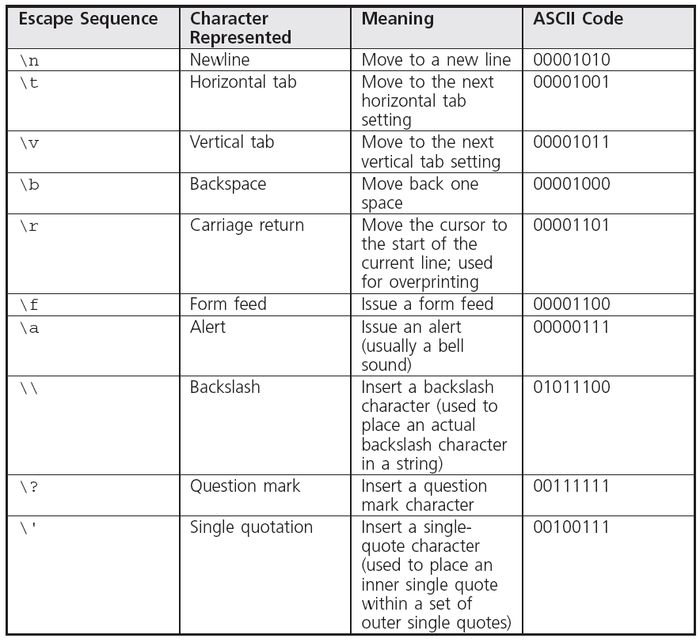
Escape Sequences

Slide 13
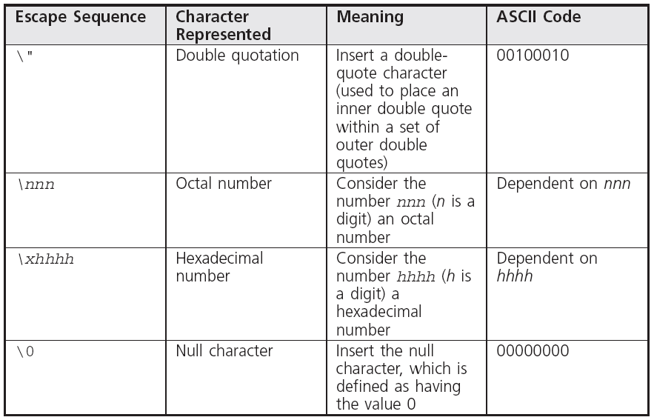
Escape Sequences (continued)

Slide 14
Escape Sequences
Examples: What is displayed in each case below?
x = 2;
y = 3;
cout << x << y << endl;
cout << x << “\n” << y “\n”;
cout << x << “\t” << y
<< “\n” << y << “\t” << x << “\n”;
cout << “x\\y < y\\x” << endl;
cout << “\”What\’re you doing\?\””;
Results:

Slide 15
Program Input using cin
cin is referred to as an “object” in C++.
cin is an input object that receives data from a standard input display device, such as the keyboard.
We will always use cin to input information from the keyboard.
Form:
cin >> value
>> is referred to as the “extraction operator”
Example:
cout << “Please enter the value of x: ”;
cin >> x;
Receive the value for x from the keyboard

Slide 16
Examples: Program Input using cin
cout << “Please enter x: ”;
cin >> x;
cout << “Please enter y: ”;
cin >> y;
Note: Multiple inputs should be separated by white spaces. White spaces are:
Spaces
Tabs
Carriage returns (Enter Key)
cout << “Please enter x and y: ”;
cin >> x;
cin >> y;
cout << “Please enter x and y: ”;
cin >> x >> y;
cin >> “Please enter x” >> x;
Invalid

Slide 17
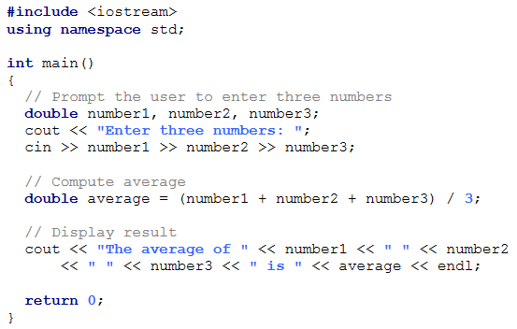
Example: Reading Multiple Inputs in One Statement
In the example below, the user enters 3 numbers and the average is calculated. Run the program separating the 3 inputs by:
1) Spaces 2) Tabs 3) Carriage returns 4) Commas
Did all cases work correctly?
Note: The online program that executes this code will not accept tabs between the values. It would work fine if compiled using DevC++.
ComputeAverage
Run

Slide 18
Adding comments to programs
Comments: Explanatory remarks in the source code added by the programmer
Line comment: Begins with // and continues to the end of the line
Line comment can be on a line by itself, or at the end of a line of code
Line comment cannot be longer than one line
Examples:
// Homework Problem 4-1
#include <iostream> //library needed to use cin and cout
int main()
{
double Q = -1.6022E-19; //charge on electron

Slide 19
Adding comments to programs (continued)
Block comments: Span across two or more lines
Begin with /* and ends with */
Useful for:
Sections with many comments, such as problem background or logos
Temporarily “commenting out” a section of a program while you debug it.
Example:
/* This is a block comment that
spans
across three lines */

Slide 20
Identifiers
A variable name is referred to as an identifier
Must declare all variable names
List name and type. Example: double Volume;
Identifier Names
type
Identifier name
Use letters, numbers, and underscores only
First character must be letter or an underscore
Other characters may be letters (a-z, A-Z), _, or digits 0-9
Cannot use C++ keywords (reserved words – see next page)
Cannot have blanks within identifiers
It is a good idea to keep length to 31 characters although longer names are possible (older compiler restriction)
Use descriptive names
Example: Use Area_Of_Circle instead of x

Slide 21
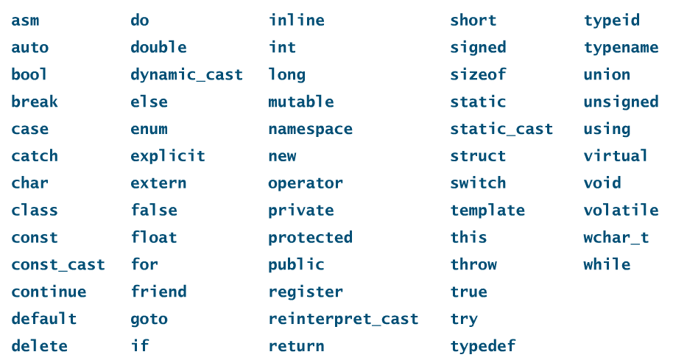
Keywords – From Appendix A in the textbook
Invalid names for identifiers
Reserved words with special meaning to C++
Note: You are only responsible for knowing keywords corresponding to instructions that we have used up until the time of a test.

Slide 22
Class Exercise – Circle the invalid identifiers below
Invalid_Name
Time-Out
3rd_Quarter
XXXXXXXXXXXXXX
EGR 125
125EGR
EGR125-D01B
Voltage_Across_Resistor
One_Plus_One_Is_Three
triple
double
Integer
dot.com
doubletime
DevC++
_A_
α
Alpha
float
tax_return
long
not so long

Slide 23
Declaring Variables
All variables MUST be declared.
List name and data type.
Data types include int, float, double, char, … (more details later)
Variables of same type may be declared in same statement (separate by comma).
Causes C++ compiler to know size of space to be reserved for storing variable’s value
Examples:
int A;
int X, Y, Z;
float area, volume;
double slope, maximum;
char Middle_Initial, Letter_Grade;

Slide 24
Assignment Statements
Form: variable_name = value or expression;
Single variable name MUST appear on left
Equal sign is called the assignment operator
Be careful: = does NOT mean “equal”
Example: x = x + 2; means x_{new} = x_{old} + 2;
Example:
x = 4;
x = x + 3;
cout << x ;
// What value is displayed
for x? __________
Why would the equation below be incorrect in a math class?
x = x + 2

Slide 25
Class Exercise – Circle the invalid assignments below. Rewrite them correctly.
double x , y;
int A, B, C;
x = 1.23;
2.4 = y;
A = B + C;
A + B = C;
A = A;
A = A-4;
A = A*A +(A-1)/A;
2 = A;
A + 2 = A;

Slide 26
Declaring variables and assigning values
Variables can be declared and values can be assigned to the variables in separate statements or in combined statements.
Example: The instructions in the two boxes below are equivalent.
int A;
A = 3;
double x, y, z;
x = 15.2;
y = -2.5;
int A = 3;
double x = 15.2, y = -2.5, z;

Slide 27
Class Exercise (Declaring and assigning) – Write expressions for each part below.
Declare two integer variables named Max and Min (in a single statement)
Answer:
Declare a variable for a real number named mass_density and assign it a value of 3650.0 (in a single statement)
Answer:
Declare three integer variables named Test1, Test2, and Test2 and assign them the values of 76, 92, and 85, respectively (in a single statement).
Answer:

Slide 28
Named Constants
A named constant is an identifier that represents a permanent value. They cannot be modified later in the program.
Useful for constants such as π, acceleration due to gravity, density for a specific material, etc.
Style: Constant variable names often use all letters in UPPER CASE
Form:
const datatype CONSTANTNAME = value;
Examples:
const double PI = 3.14159;
const int MAX_GRADE = 100;
const double G = -9.81; // acceleration due to gravity
// in m/s^2

Slide 29
C++ data types Variables are typically assigned a data type. Example: int x; //integer data type double y; //real number (floating point) data type
There are several data types available in C++, including:
Integers (including int, short int, unsigned short, unsigned int,
long int, unsigned long int, etc.)
Real numbers (including float, double, and long double)
Characters (char)
Boolean (bool)
Strings (string)
More details to follow on data types

Slide 30
Integer data types Integers are numbers without decimal points. Exceeding the range may yield unexpected results as values cycle through the range (see discussion in text).
Integer data type | Number of bytes | Range
short int | 2 | -32768 to 32767
unsigned int unsigned short int | 2 | 0 to 65535
int * int signed * long int | 4 | -2147483648 to 2147483645
unsigned long int | 4 | 0 to 4294967295
Some older compilers might only use 2 bytes for int and int signed
Examples:

Slide 31
Real data types Real numbers are numbers with decimal points. They may be in scientific notation or in fixed-point notation. Exceeding the range may yield “overflow” or “underflow” errors.
Real data type | Number of bytes | Number of sig. digits | Range
float | 4 | 6 | ±3.4e-38 to ±3.4e+38
double | 8 | 15 | ±1.7e-308 to ±1.7e+308
long double | 10 | 19 | ±3.4e-4932 to ±1.1e+4932
Examples: (include examples in scientific notation)

Slide 32
Literals and scientific notation Literals are constant values used in a program. Example: int J = 36; // 36 in an integer literal double velocity = 55.2; // 55.2 is a floating point literal Scientific notation can also be used for floating point literals. Example: 1.23 x 10⁴ can be represented as 1.23E4 or 1.23e4
Examples: Declare an appropriate variable and express each result using scientific notation.
Q = -1.6022x 10⁻¹⁹ Answer:
Cost = 3.2 billion Answer:
c) Energy = 348.8 x 10⁺¹² Answer:

Slide 33
Character Data Type (char)
A character consists of any single symbol enclosed in single quotes
Escape sequences (such as \t, \n, \r, \v) are regarded as a single character
C++ actually assigns the ASCII code (see Table 3.5 on next page) for the character, so you can think of a character as essentially acting like an integer
Example:
char c1 = ‘J’;
char Middle_Initial = ‘W’;
char tab = ‘\t’;
Additional Examples:

Slide 34
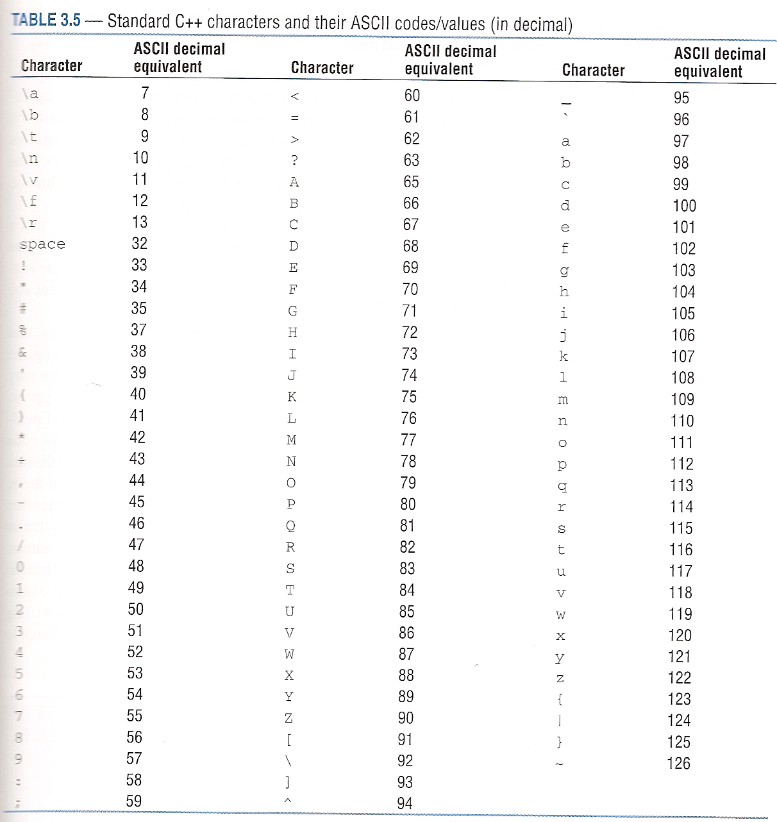
Example:
The following two commands have the same effect:
char c1 = ‘A’;
char c1 = 65;
Additional Examples:

Slide 35
Arithmetic Operations
Look like algebraic expressions
Expression consists of sequence of operand(s) and operator(s)
Operand (variable, constant, any value)
Most common operators (+, - , * , / , % )
Example: (describe the output of the program below)
int a, b, c, d;
a = 4;
b = 2;
c = (a + b)/(a - b); // algebraic expression
d = a*b - a/b; // algebraic expression
cout << “c = “ << c << endl;
cout << “d = “ << d << endl;

Slide 36
Common Operators for Arithmetic Operations
Operator | Operation | Operands | Notes
+ | Addition, unary plus | Real or integer | Overloaded operator has two functions
- | Subtraction, unary minus | Real or integer | Overloaded operator has two functions
* | Multiplication | Real or integer | Overloaded operator has two functions
/ | Real and integer division | Real or integer | Overloaded operator has two functions
% | Modulus | Integer | Remainder for integer division
i/j and i%j are undefined for j = 0
Discuss operator overloading
Example: What value is assigned to x in each case?
x = 7%3;
x = 3%7;
x = 7%7;

Slide 37
Mixed-type operations - Avoid unless necessary or intentional - Form: Result = (Operand #1) Operator (Operand #2)
Operand #1 | Operand #2 | Result
Integer | Integer | Integer
Real | Integer | Real
Integer | Real | Real
Real | Real | Real
Notes:
If a real result is converted to an integer, it is truncated (chopped off after the decimal point, not rounded off).
If a real value is assigned to an integer variable, it is truncated.
If an integer value is assigned to a real variable, it is promoted to a real (decimal point added).

Slide 38
Mixed-type operations
Example: What is the result of each operation below?
18/4/3
18/4/3.
18/4./3
18./4/3
Example: What value is assigned to each variable below?
int I1, I2;
double D1, D2;
I1 = 6.9;
D1 = 4;
I2 = 14/5.0;
D2 = 14/5;

Slide 39
Operator Precedence Key Rule: Evaluate multiplication and division before addition and subtraction.
Precedence | Operator | Order of operation
Highest | ( ) parentheses | Innermost first
 | Unary plus (+) or unary minus (-) | Right to left
 | Multiplication (*) or Division (/) or Modulus (%) | Left to right
Lowest | Addition (+) or Subtraction (-) | Left to right
Example: Evaluate each expression below:
a = 12/2 + 4*3;
b = 12/(2 + 4)*3;
c = 20%6%4;
d = 4*-3;

Slide 40
Increment and decrement operators
++ is the increment operator
- - is the decrement operator
x++ or ++x means x = x + 1
x- - or --x means x = x – 1
Example: Determine the value of A printed below.
A = 4:
A++; // post-increment operator
++A: // pre-increment operator
cout << “A = “ << A << endl; A = ____________
When these operators are used with assignment it makes a difference which one is used.
When placed in front, incrementing or decrementing occurs BEFORE value assigned
When placed in back, occurs AFTER value assigned.
Ex: A = B++; // Assign B to A and then increments B
Ex: A = ++B; // Increment B and then assign new value of B to A

Slide 41
Example: Evaluate each expression below:
int a = 3, b = 4, c = 5, d = 6;
int e, f, g, h;
a++;
b--;
e = c++;
f = ++c;
g = d--;
h = --d;
// Result: a = _________
// Result: b = _________
// Result: e = _________
// Result: c = _________
// Result: f = _________
// Result: c = _________
// Result: g = _________
// Result: d = _________
// Result: h = _________
// Result: d = _________

Slide 42
Compound Assignment Operators (Shortcut Operators)
Several shortcut operators are available in C++.
The examples below explain how the operators function.
Shortcut Operator | Meaning
A += B; | A = A + B;
A -= B; | A = A - B;
A *= B; | A = A * B;
A /= B; | A = A / B;
A %= B; | A = A % B;
Example: Evaluate each expression below:
int a = 2, b = 3, c = 4, d = 5, e= 6;
a +=3;
b -=3;
c *= 3;
d /= 3;
e %= 3;

Slide 43
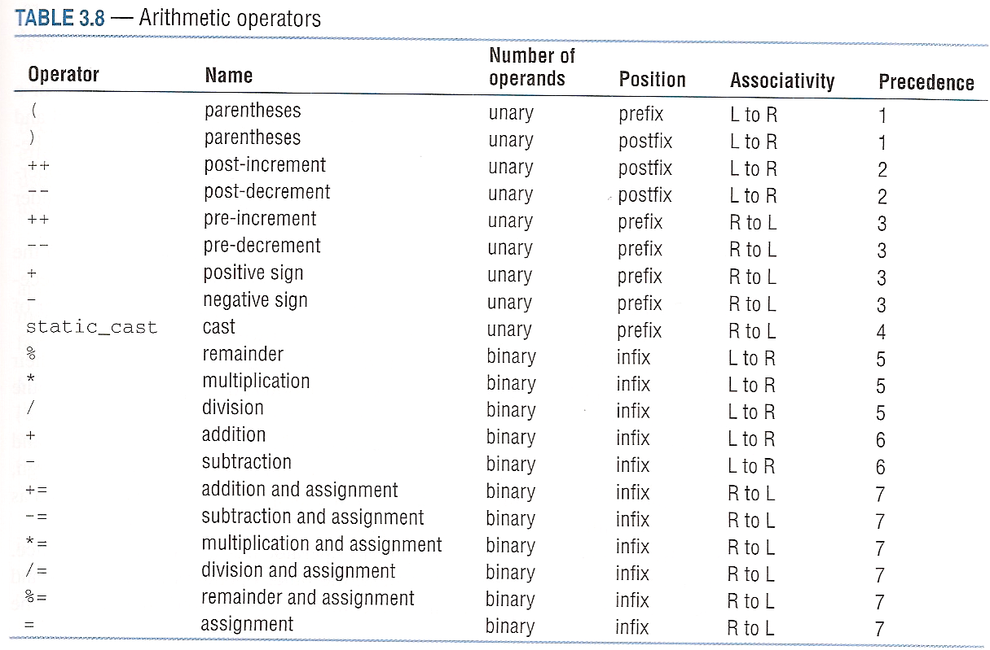
Arithmetic Operators
The table below provides a more complete list of arithmetic operators and operator precedence. Also see Appendix C in the text.

Slide 44
Numeric Type Conversions (type casting)
We have already seen that:
If a real value is assigned to an integer variable, it is truncated.
If an integer is assigned to a real variable, it is promoted.
Example: Promotion and truncation
int A = 12.9; // A = 12
double X = 7; // X = 7.0
double Y = A; // Y = 12.0
double Z = 1.25; // Z = 1.25
int B = Z; // B = 1
You can also use a casting operator to convert from one type to another.
Form: static_cast<type> (value) // recommended C++ style
or (type) value // older C-style
Example: Type casting
double A = static_cast<int>(6.8); // A = 6.0
int N = 1;
double B = N/3; // B = 0.0;
double B = static_cast<double>(N)/3; // B = 0.3333
// Note that N is unchanged (N = 1)

Slide 45
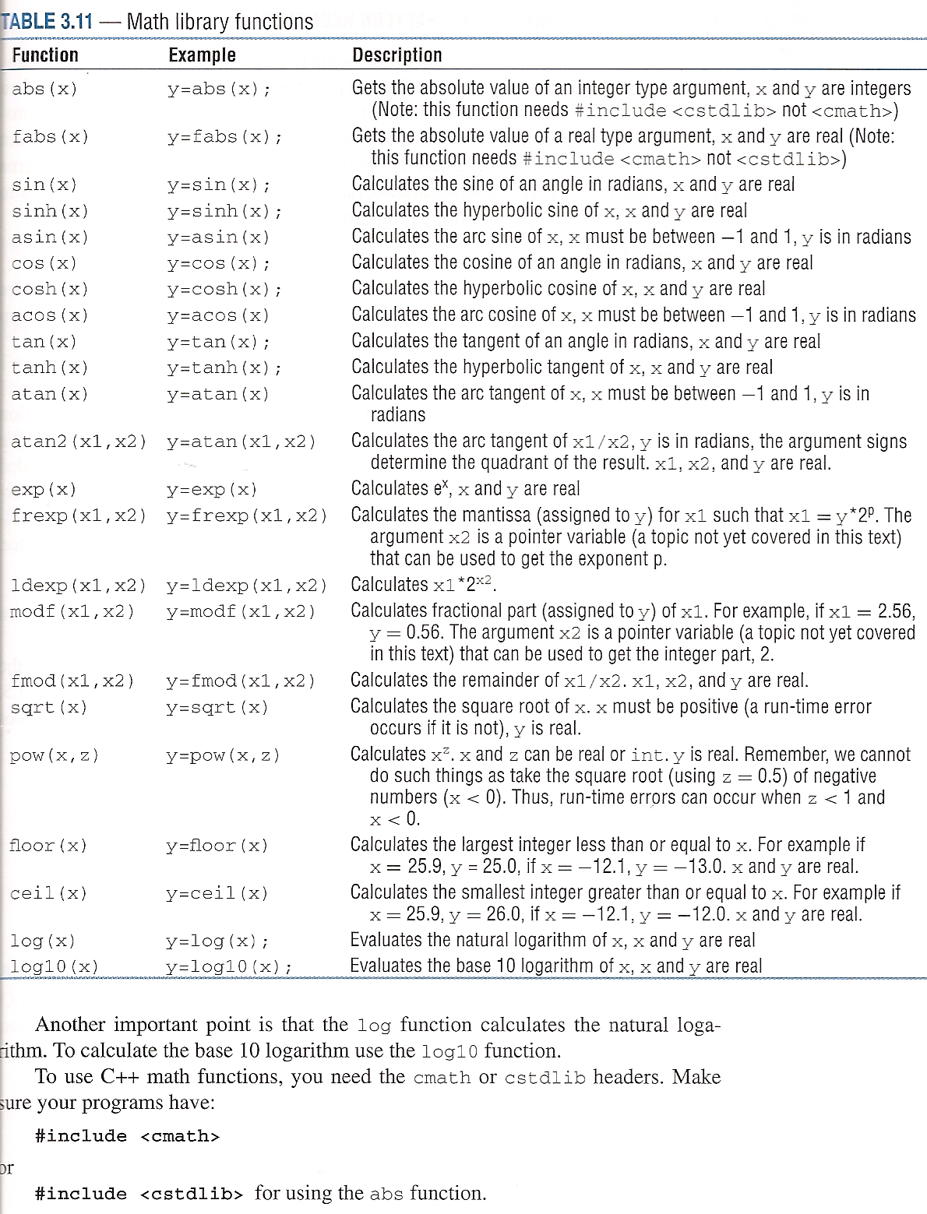
Math Functions
Need cmath or cstlib headers
#include <cmath> or #include <cstlib>
Note what type and form parameters take
Trig functions use radians not degrees
The table to the right lists some math library functions
Note that
so this is implemented in C++ as
y = pow(x,1.0/3.0);

Slide 46
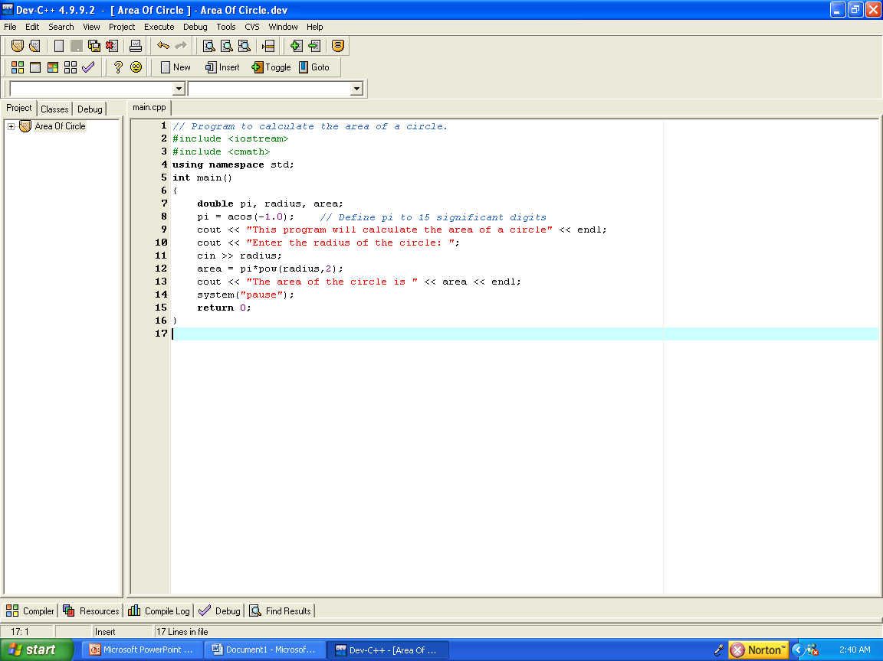
Math Functions
Example using functions from cmath:
Sample Program Output:
This program will calculate the area of a circle
Enter the radius of the circle: 20
The area of the circle is 1256.64
Press any key to continue . . .

Slide 47
Math Functions
Example: Write C++ expressions corresponding to each of the mathematical expressions below.

